Slide 1
Lung Disease Detection
Team Members:
Tanoj Kumar Anapana
Basani Sneha Latha Reddy

Slide 2
PROJECT STATEMENT
The project “Multiple Lung disease detection from chest X-Ray images using Machine Learning for Balanced Dataset” uses various Machine Learning algorithms and identifies which gives better results.

Slide 3
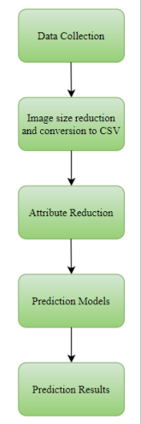
APPROACH
In this project, a dataset with 9000 images is used and these images are used to build various Machine Learning models using algorithms like Logistic Regression, Naïve Bayes, k-Nearest Neighbors, Decision Tree, Random Forest and Support Vector Machine. Three different classes are used, i.e., Normal, Pneumonia and Other. The models are built for segmented and unsegmented images. The models are built for before and after attribute reduction. Two dimensionality reduction techniques are used: PCA and LDA.

Slide 4
DELIVERABLES
A python code in which various algorithms are applied to detect the lung diseases from segmented and un-segmented chest X-rays.
A GitHub repository link for project code.
Code Walkthrough Video on YouTube.

Slide 5
EVALUATION METHODOLOGY
The Machine learning model is Trained by using Various Algorithms which were mentioned in Slide 3
Will be analysing the lung diseases using various Machine Learning Algorithms and produces which Algorithm gives the best results for both Segmented and unsegmented Images.

Slide 6
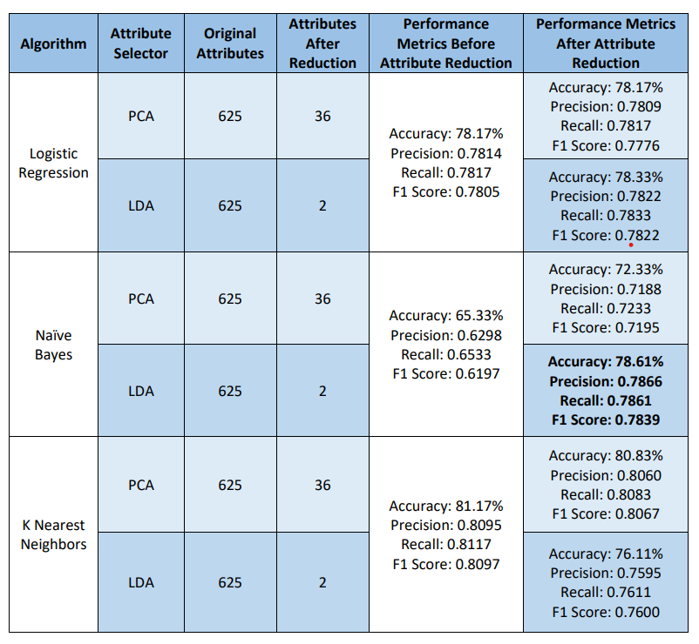
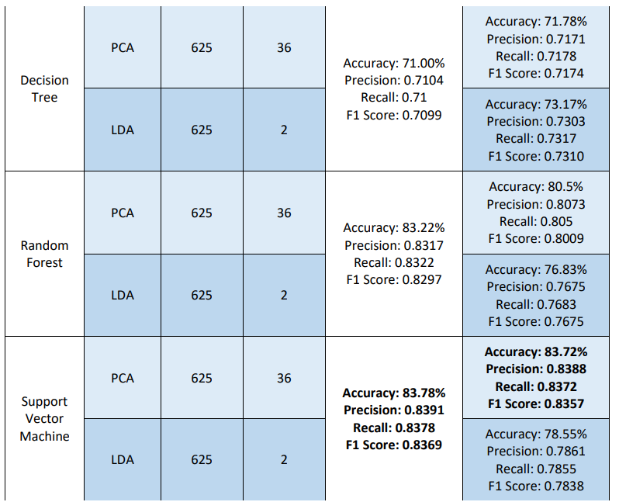
RESULTS – Unsegmented lung images
The best results for unsegmented images is given by the Support Vector Machine with almost 83% accuracy.

Slide 7
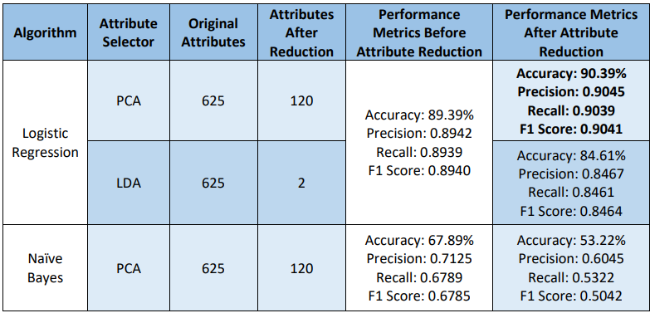
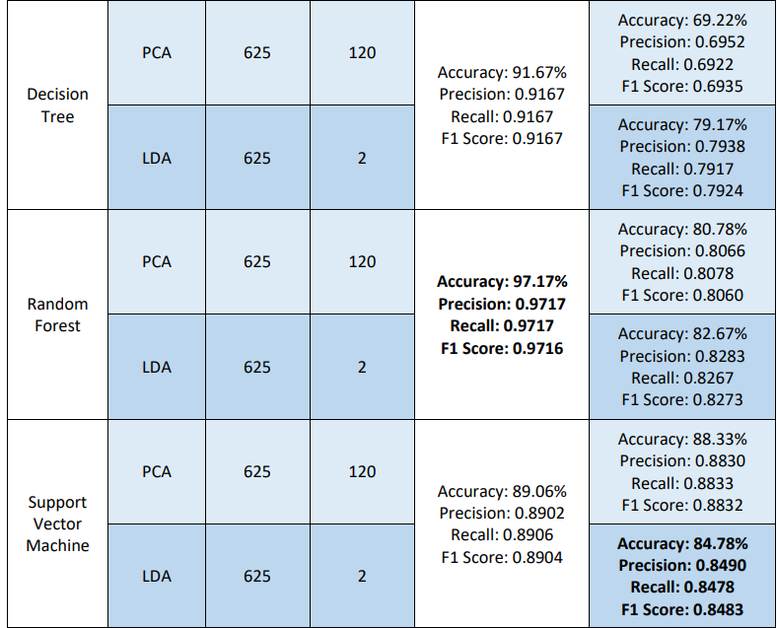
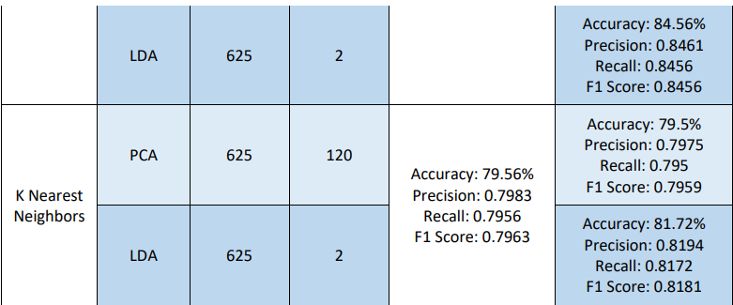
RESULTS – Segmented lung images
The best results for segmented images is given by the Random Forest with almost 97% accuracy.

Slide 8
CONCLUSION
The best results without attribute reduction are observed for Random Forest with a 97.17% accuracy on segmented images and 83.78% on unsegmented images for Support Vector Machine. When the attributes were reduced using PCA, the best accuracy of 90.39% is observed using Logistic Regression on segmented images and 83.72% using Support Vector Machine on unsegmented images. With the dimensions being reduced using LDA, an accuracy of 84.78% with a model built using Support Vector Machine is observed on segmented images and 78.61% using Naïve Bayes on unsegmented images. It can be observed that segmented images give better results than unsegmented images

Slide 9
Thank You

